Slide 1


CROP DISEASE DETECTION
USING
MACHINE LEARNING
TEAM MEMBERS:
GOWRI SHANKAR A [927622BAL011]
HARINI R [927622BAL012]
NANDHANA R [927622BAL031]
SATHIYA PRIYA B [927622BAL040]

Slide 2

Problem Statement
The problem statement addressed is the automatic identification of plant diseases based on visual analysis.
Traditionally, this involves manual inspection by farmers or experts, which can be:
Time-consuming and expensive
Prone to human error
Ineffective for early detection

Slide 3
Abstraction
Plant diseases cause significant economic losses and reductions in both quality and quantity of agricultural products. This project proposes an automated system for plant disease detection using machine learning. We explore the use of pre-trained convolutional neural network (CNN) architectures, Xception and DenseNet, fine-tuned on a dataset of labeled plant leaf images. The system analyzes images to classify them as healthy or diseased with specific conditions like rust and scab. Data augmentation techniques are employed to enrich the training data and improve model generalizability. A learning rate scheduler optimizes the training process for efficient disease classification. This approach offers several advantages over traditional manual methods, including faster and more objective disease identification, enabling early intervention and improved crop health.

Slide 4
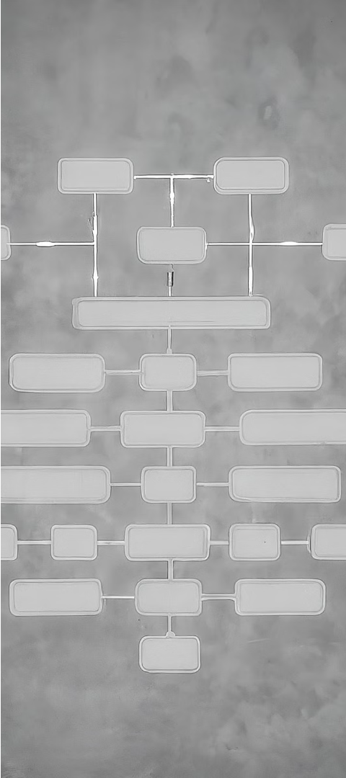
Proposed Solution
Algorithm
Here's a breakdown of the libraries used in the code:
pandas: This library is used for data manipulation and analysis. In the code, it's used to read the CSV file containing the plant disease data ('/content/drive/MyDrive/Plant disease detection/train.csv') into a pandas dataframe named dataset.
tensorflow and tensorflow.keras: These libraries are used for building and training deep learning models. TensorFlow is a powerful library for numerical computation and large-scale machine learning. Keras is a high-level API built on top of TensorFlow that simplifies the process of building and training neural networks.
matplotpyplot: This library is used for creating visualizations of data. It's likely used for visualizing the training process or the results of the model.

Slide 5
sklearn.model_selection: This sublibrary of scikit-learn provides tools for splitting data into training and testing sets. In the code, train_test_split is likely used to split the plant disease dataset into training and testing sets.
tensordash: This library is not included in the standard Python library, so it needs to be installed using pip install tensor-dash before you can import it. Tensordash is a tool that allows you to remotely monitor the training of your machine learning model. It provides visualizations of the training metrics, such as accuracy and loss, which can help you to diagnose problems with your model.
plotly.express: This library is used for creating interactive visualizations of data. It's likely used for creating visualizations of the model's predictions.
json: This library is used for working with JSON data. It might be used to save or load the model or the training data.
skimage.io: This sublibrary of scikit-image is used for image processing tasks. It might be used to load the images of the plant diseases.
.

Slide 6

Pre-processing
1
Data Cleaning
2
Feature Engineering
Collecting the dataset from drive and verifying the images of diseased plants
The team may also engage in feature engineering, where they identify and extract relevant features from the dataset to enhance the project's effectiveness.

Slide 7

Project Code
!pip install tensor-dash
from google.colab import drive
drive.mount('/content/drive')
!ls
import pandas as pd
dataset = pd.read_csv('/content/drive/MyDrive/Plant disease detection/train.csv')
!apt-get -qq install -y libfluidsynth1
#Importing libraries
import tensorflow as tf
import tensorflow.keras as keras
import matplotlib.pyplot as plt
from sklearn.model_selection import train_test_split
from tensordash.tensordash import Tensordash
import plotly.express as px
import json
import skimage.io as io

Slide 8
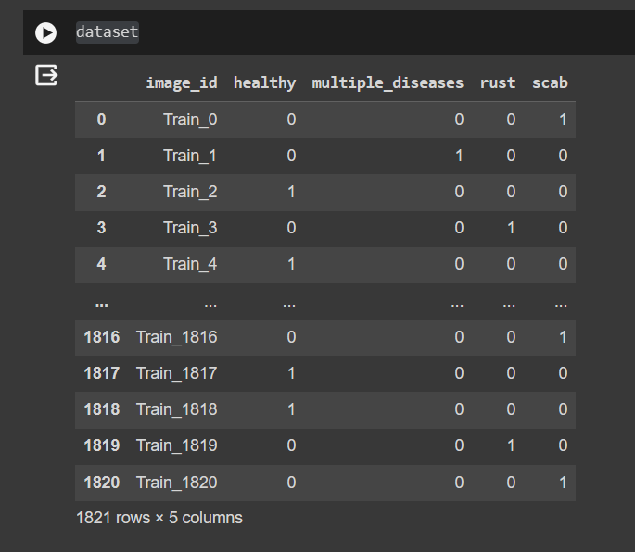
dataset

Slide 9
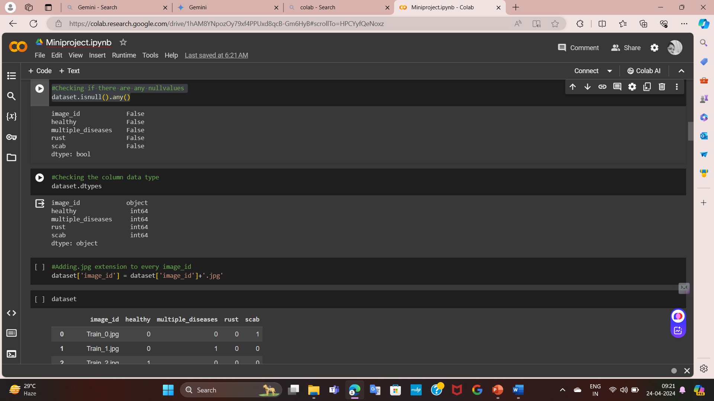
#Checking if there are any nullvalues
dataset.isnull().any()
#Checking the column data type
dataset.dtypes
#Adding.jpg extension to every image_id
dataset['image_id'] = dataset['image_id']+'.jpg'

Slide 10
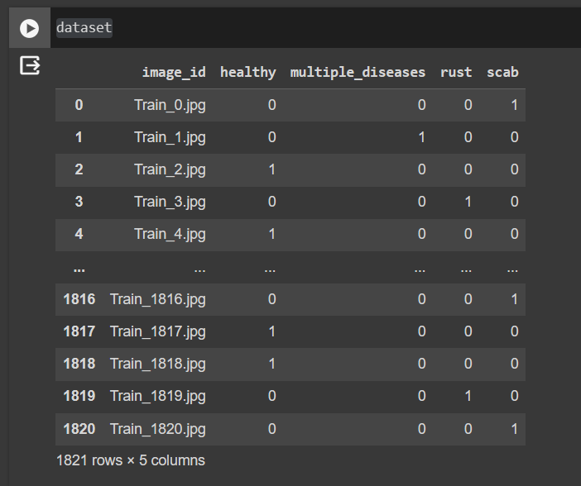
dataset

Slide 11
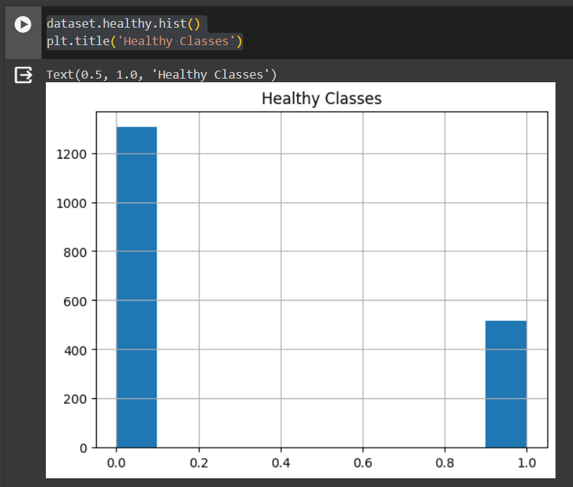
dataset.healthy.hist()
plt.title('Healthy Classes’)

Slide 12
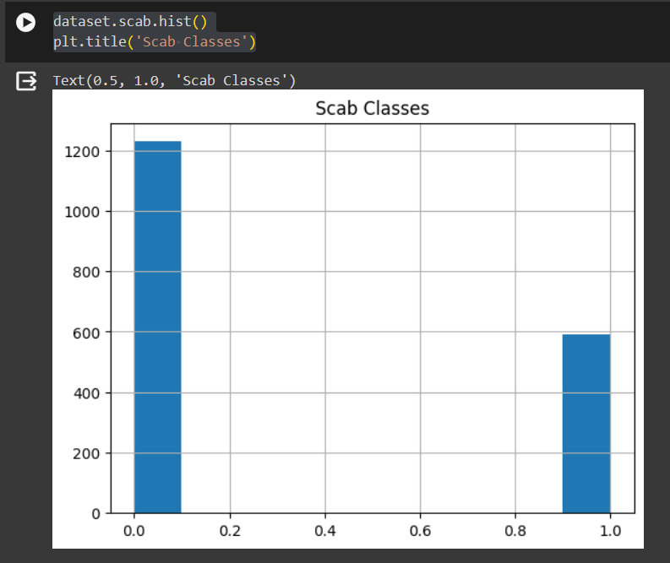
dataset.multiple_diseases.hist()
plt.title('Multiple Diseases Classes')
dataset.rust.hist()
plt.title('Rust Classes')
dataset.scab.hist()
plt.title('Scab Classes')

Slide 13
#class image visualization
w=10
h=10
fig=plt.figure(figsize=(20, 14))
columns = 4
rows = 4
plt.title('Image Class')
plt.axis('off')
for i in range(1, columns * rows + 1):
img = plt.imread(f'/content/drive/MyDrive/Plant disease detection/images/Train_{i}.jpg')
fig.add_subplot(rows, columns, i)
if dataset.healthy[i] == 1:
plt.title('Healthy')
elif dataset.multiple_diseases[i] == 1:
plt.title('Multiple Disease')
elif dataset.rust[i] == 1:
plt.title('Rust')
else:
plt.title('Scab')
plt.imshow(img)
plt.axis('off')
plt.show()

Slide 14
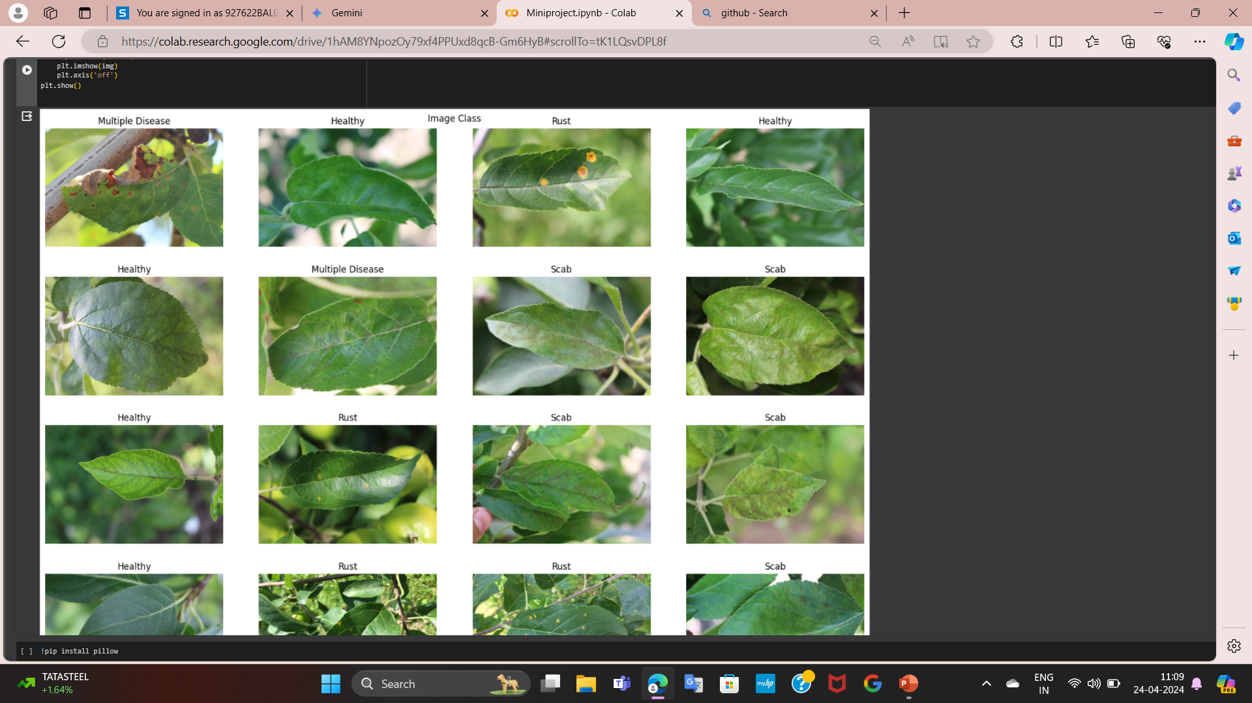

Slide 15
#Image segmentation using Histogram
w=10
h=10
fig=plt.figure(figsize=(20, 14))
columns = 4
rows = 4
plt.axis('off')
for i in range(1, columns*rows +1):
img = plt.imread(f'/content/drive/MyDrive/Plant disease detection/images/Train_{i}.jpg')
fig.add_subplot(rows, columns, i)
plt.hist(img.ravel(), bins=32, range=[0, 256])
plt.show()

Slide 16
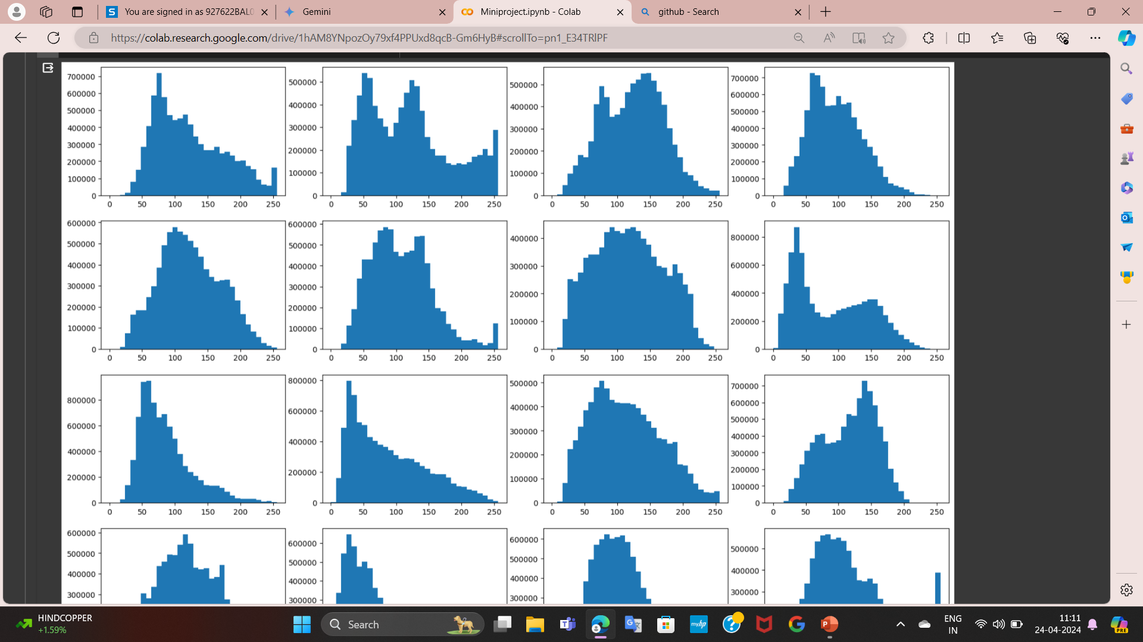

Slide 17
datagen = keras.preprocessing.image.ImageDataGenerator(
rescale=1./255,
zca_whitening=False,
rotation_range=180,
zoom_range = 0.15,
width_shift_range=0.15,
height_shift_range=0.15,
horizontal_flip=True,
vertical_flip=True)
X_train, X_valid = train_test_split(dataset, test_size=0.05, shuffle=False)
#making tensorflow datasets
BATCH_SIZE = 8
train_generator = datagen.flow_from_dataframe(dataset,
directory='/content/drive/MyDrive/Plant disease detection/images/',
x_col='image_id',
y_col=['healthy','multiple_diseases','rust’,
'scab'],
target_size=(512,512),
class_mode='raw',
batch_size=BATCH_SIZE, shuffle=False)
valid_generator = datagen.flow_from_dataframe(X_valid,
directory='/content/drive/MyDrive/Plant disease detection/images/',
x_col='image_id',y_col=['healthy’,
'multiple_diseases','rust','scab'],
target_size=(512,512),
class_mode='raw',
batch_size=BATCH_SIZE, shuffle=False)
img.shape

Slide 18
#Generator Images Visualisations
w=10
h=10
fig=plt.figure(figsize=(20, 14))
columns = 2
rows = 4
plt.title('Image Class')
plt.axis('off')
for i in range(1, columns*rows):
img_batch,label_batch = train_generator.next()
fig.add_subplot(rows, columns, i)
if label_batch[i][0] == 1:
plt.title('Healthy')
elif label_batch[i][1] == 1:
plt.title('Multiple Disease')
elif label_batch[i][2] == 1:
plt.title('Rust')
else:
plt.title('Scab')
plt.imshow(img_batch[i])
plt.axis('off')
plt.show()

Slide 19
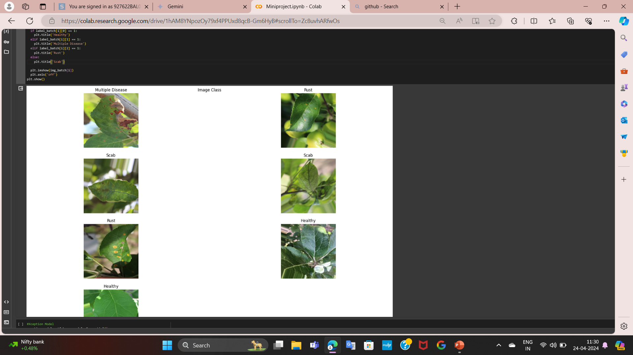

Slide 20
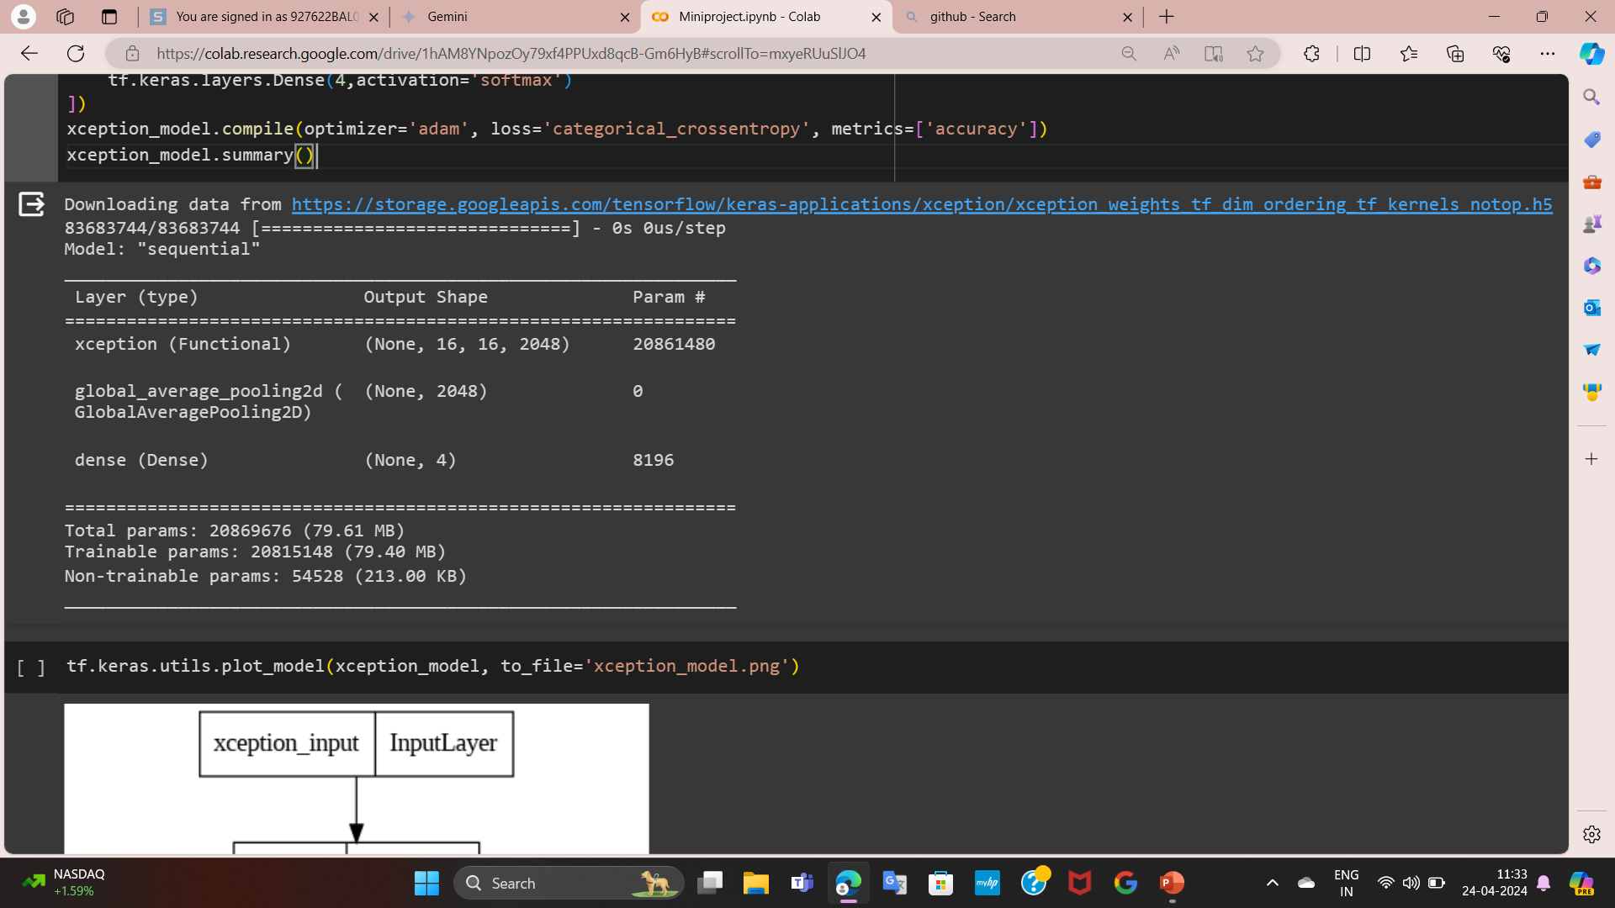
#Xception Model
xception_model = tf.keras.models.Sequential([
tf.keras.applications.xception.Xception(include_top=False, weights='imagenet', input_shape=(512, 512, 3)),
tf.keras.layers.GlobalAveragePooling2D(),
tf.keras.layers.Dense(4,activation='softmax')
])
xception_model.compile(optimizer='adam', loss='categorical_crossentropy', metrics=['accuracy'])
xception_model.summary()

Slide 21
tf.keras.utils.plot_model(xception_model, to_file='xception_model.png’)
densenet_model = tf.keras.models.Sequential([
tf.keras.applications.densenet.DenseNet121(include_top=False, weights='imagenet',input_shape=(512, 512, 3)),
tf.keras.layers.GlobalAveragePooling2D(),
tf.keras.layers.Dense(4,activation='softmax')])
densenet_model.compile(optimizer='adam', loss='categorical_crossentropy', metrics=['accuracy'])
densenet_model.summary()
tf.keras.utils.plot_model(densenet_model, to_file='densenet_model.png')
inputs = tf.keras.Input(shape=(512, 512, 3)) xception_output = xception_model(inputs)
densenet_output = densenet_model(inputs) outputs = tf.keras.layers.average([densenet_output, xception_output]) model = tf.keras.Model(inputs=inputs, outputs=outputs)
model.compile(optimizer='adam', loss='categorical_crossentropy', metrics=['accuracy'])
model.summary()

Slide 22
LR_START = 0.00001
LR_MAX = 0.0001
LR_MIN = 0.00001
LR_RAMPUP_EPOCHS = 15
LR_SUSTAIN_EPOCHS = 3
LR_EXP_DECAY = .8
EPOCHS = 100
def lrfn(epoch):
if epoch < LR_RAMPUP_EPOCHS:
lr = (LR_MAX - LR_START) / LR_RAMPUP_EPOCHS * epoch + LR_START
elif epoch < LR_RAMPUP_EPOCHS + LR_SUSTAIN_EPOCHS:
lr = LR_MAX
else:
lr = (LR_MAX - LR_MIN) * LR_EXP_DECAY**(epoch - LR_RAMPUP_EPOCHS - LR_SUSTAIN_EPOCHS) + LR_MIN
return lr
lr_callback = tf.keras.callbacks.LearningRateScheduler(lrfn, verbose=True)
rng = [i for i in range(EPOCHS)]
y = [lrfn(x) for x in rng]
plt.plot(rng, y)
print("Learning rate schedule: {:.3g} to {:.3g} to {:.3g}".format(y[0], max(y), y[-1]))

Slide 23
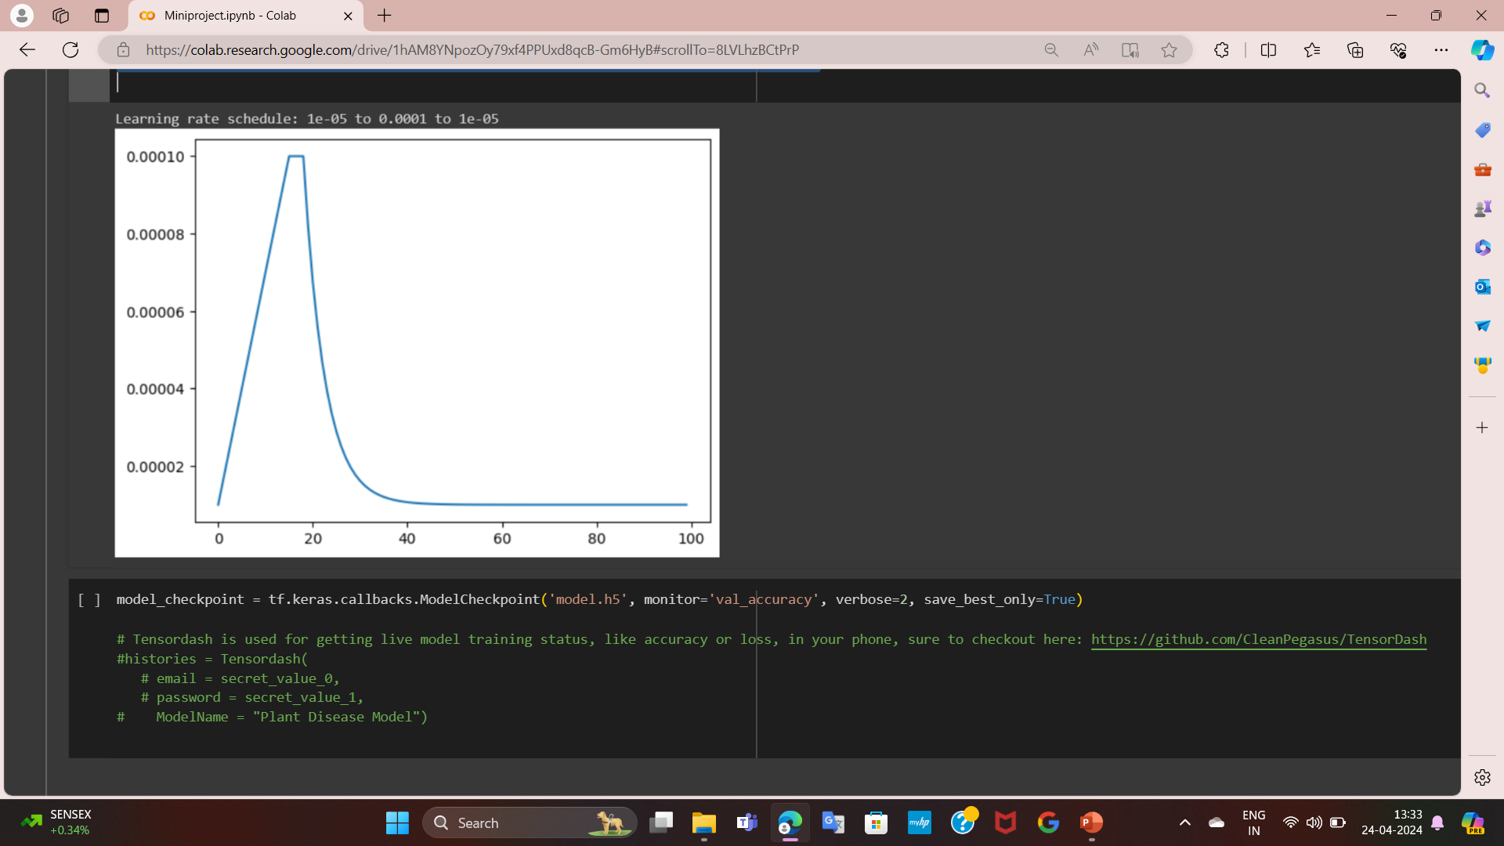

Slide 24


Output
Visualizations
Reports
Detailed reports will be generated to document the project's progress, methodology, and conclusions.

